Slide 1
Big game census analytics

Slide 2
Agenda
Introduction
Data enrichment process
Data preparation
Analysis
My design

Slide 3
Introduction
The Big Game Census Analytics project is designed to explore the demographics, origins, and attributes of players participating in a major sporting event, such as the Super Bowl. The project leverages data from various sources to provide insights and visualizations that highlight interesting patterns and trends.
Tools used MS Excel, Python, Pandas, NumPy, Matplotlib, Power BI.

Slide 4



DATA ENRICHMENT PROCESS

Slide 5
DATA PREPARATION
Combining Multiple Data Sources
1
Checking for Null Values in the Dataset
2
Dropping Unrequired Columns
3
Plotting Graphs using Matplotlib
4
Downloading Cleaned Files and Uploading to Visualization Tool
5

Slide 6
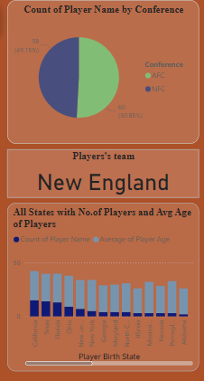
ANALYSIS
​The top pie charts show the count of player names by conference. AFC – 50.85%, NFC – 49.15%
The card shows the players’ team
The bottom graph shows the number of players and their avg age in all states

Slide 7
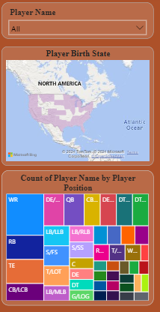
analysis
At the top features a slicer with a list of players’ names, allowing us to select and view their information.
In the middle it shows a visual map that shows the player’s birth state.
At the bottom it shows a treemap between the count of the player’s name and the player’s position.

Slide 8
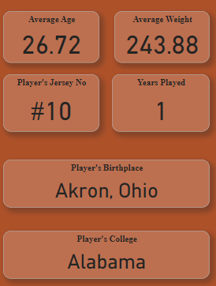
ANALYSIS
​ These cards show the average age and weight of the players, the player’s Jersey No, Years played, Their birthplace, and Their college name.

Slide 9
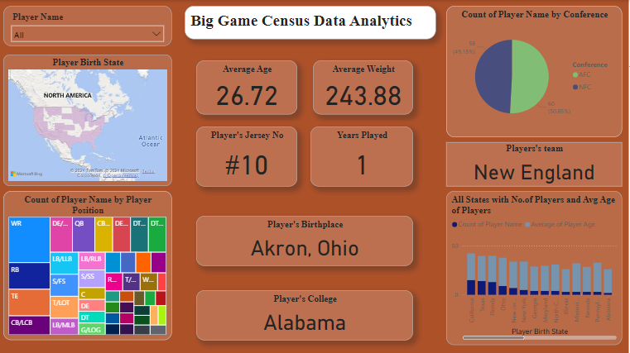
My design​

Slide 10
THANK YOU
By – V H Nidhi

